Slide 1
WIKIPEDIA DATASET ANALYSIS USING HIVE
BY: SYED RIZVI

Slide 2
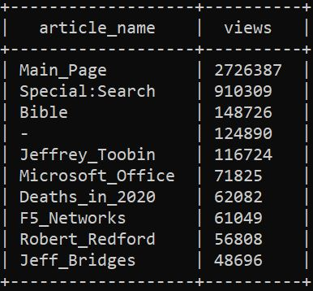
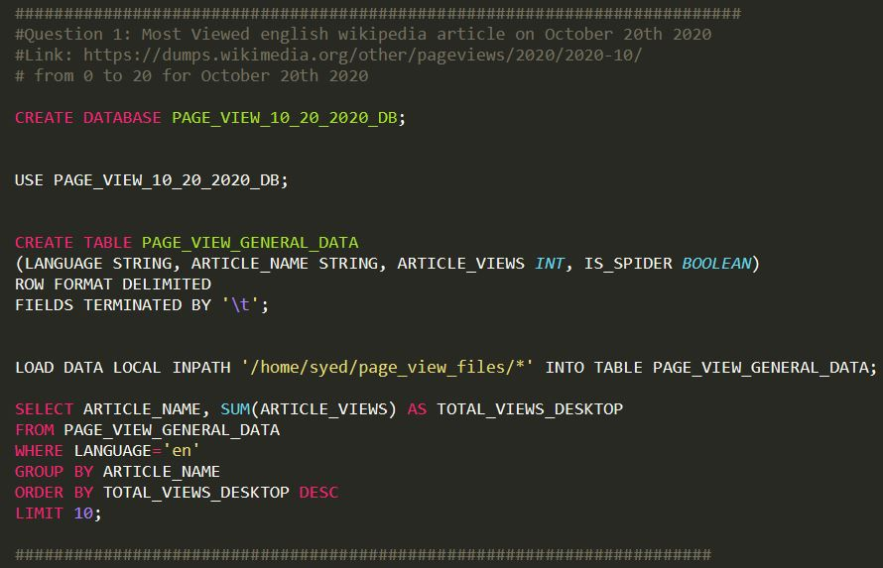
Question 1: English Wikipedia article that received largest traffic on 10/20/2020

Slide 3
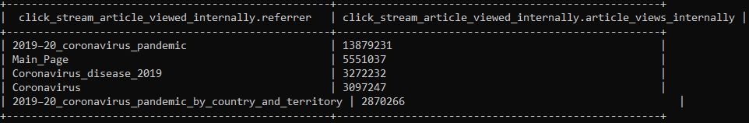
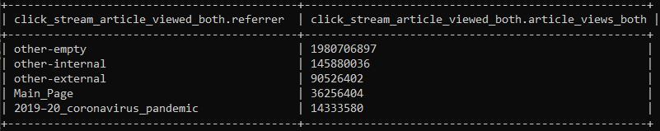
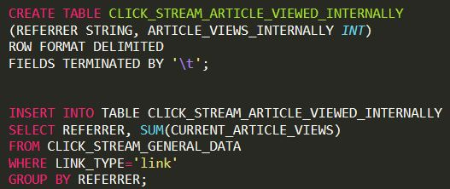
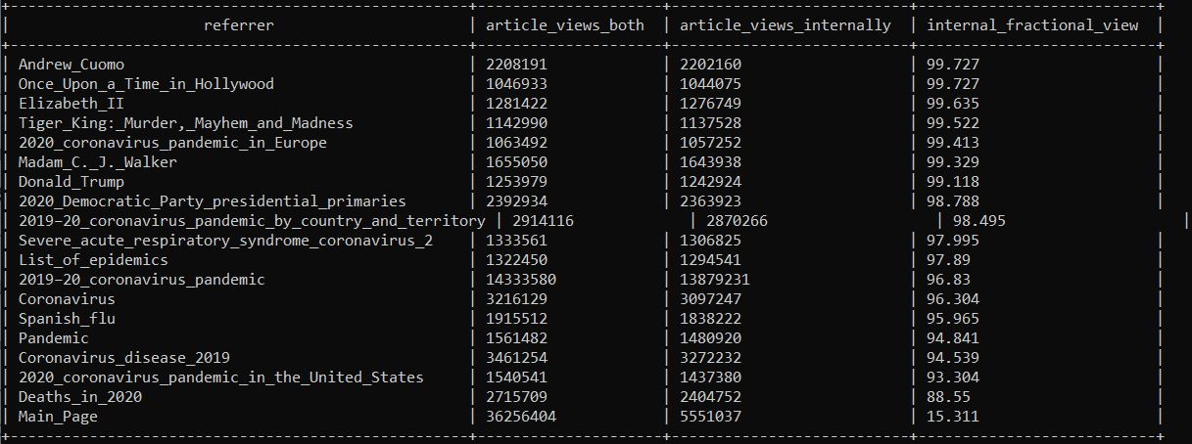
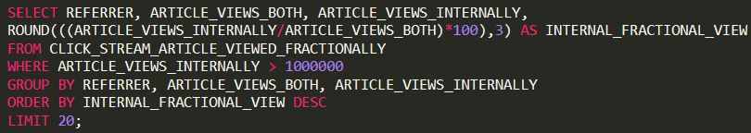
Question 2: English Wikipedia article that has the largest fraction of its readers follow an internal link to another Wikipedia article
Internal Links
Both Links
Click Stream data
Timeline:
03/11/20 – 04/11/20

Slide 4
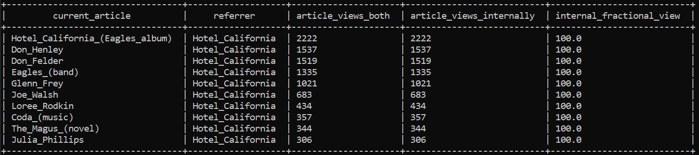
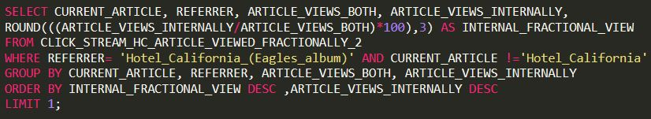
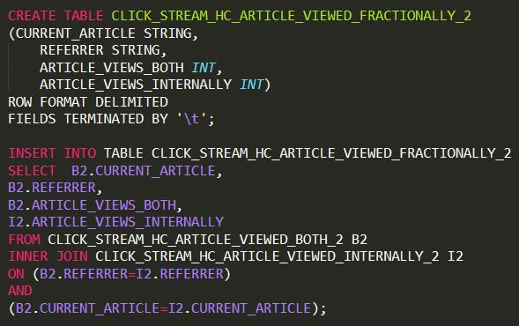
Question 3: English Wikipedia article starting with Hotel California that has the largest fraction of its readers follow an internal link to another Wikipedia article
Like inner join table from question 2 but with current articles
Click Stream data
Timeline:
03/11/20 – 04/11/20

Slide 5
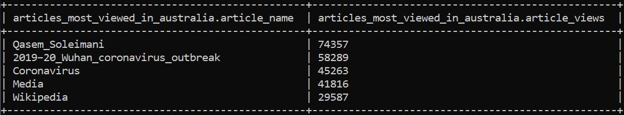
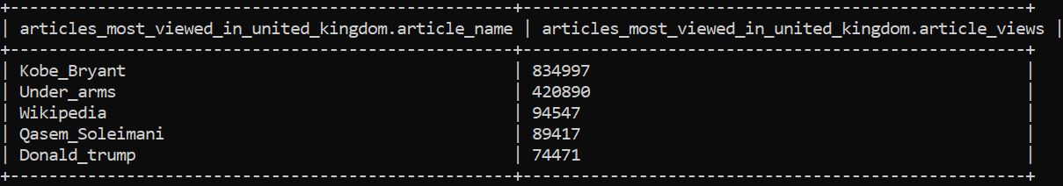
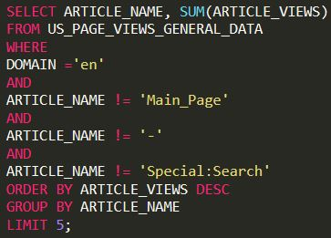
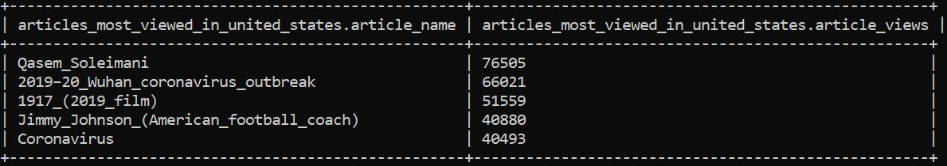
Question 4: English Wikipedia article that is relatively more popular in United Kingdom. Find the same for the US and Australia.
Australia
PEAK HOURS: 8PM – 11PM
TIMELINE: 01/01/20 – 01/31/20
DATE: 1/03, 1/13, 1/26, 1/31
UK 8pm – 11 pm | US 8pm – 11 pm | AUS 8pm – 11 pm
19:00 | 24:00 UTC | 8:00 UTC
20:00 | 1:00 UTC | 9:00 UTC
21:00 | 2:00 UTC | 10:00 UTC
22:00 | 3:00 UTC | 11:00 UTC
United Kingdom
United States

Slide 6
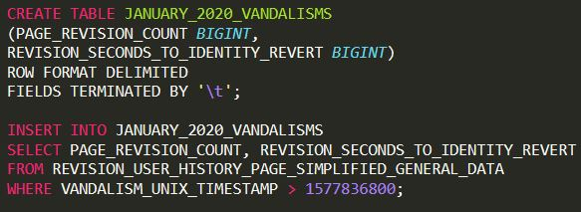
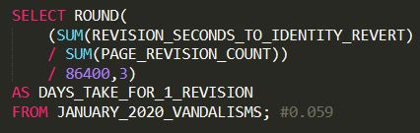

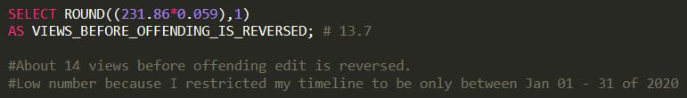
Question 5: Average views for vandalized Wikipedia page before the offending edit is reversed
TIMELINE: 01/01/20 – 01/31/20
For
Page Revision User History
Fields Utilized | WHY?!
Page Revision Count | Total revisions made
Revision seconds to revert | To get how long it takes to reverse an offending edit
First edit timestamp | To filter out data not relevant to timeline
$$\frac{Total Seconds to revert}{Total page revision count}×\frac{1 day}{86400 seconds}×\frac{average views}{1 day}=\frac{Views}{1 Page}$$

Slide 7
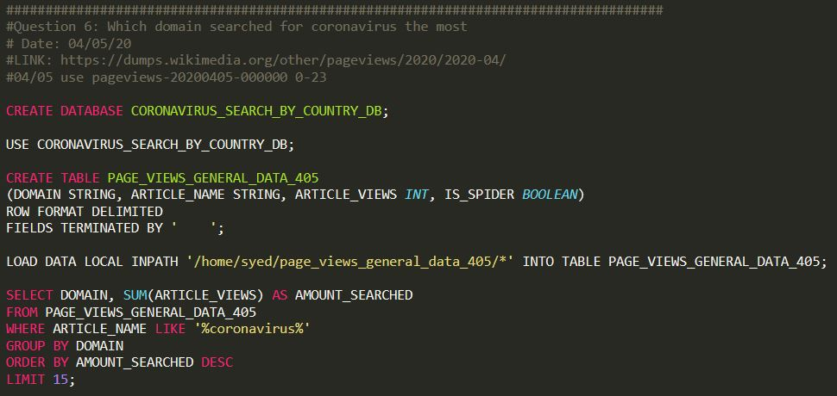
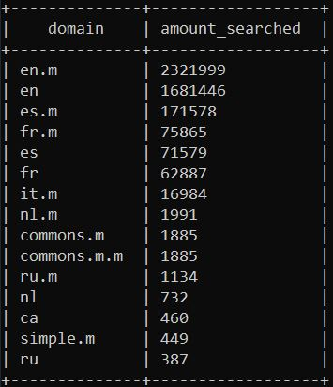
Question 6: Amount of times coronavirus searched by domains on 04/05/20 (TOP 15)
PAGE VIEWS ON 04/05/20
FILTER FOR COVID-19 searches
Then Sum, Group by, & Order by

Slide 8
THANK YOU! QUESTIONS? https://github.com/Riztech16/Project1_Revature

